Slide 1

Creating a Provisioning Solution Using Site Designs and PnPjs
Kemal Sinanagic

Slide 2
Special thanks to our sponsors

Slide 3


About me
Kemal Sinanagic | Belgium
Office 365 / SharePoint Developer |
@kemicza

Slide 4
Agenda | Session Content
PnPjs
Site Scripts & Site Designs
Combining Site Designs & PnPjs to build a provisioning solution
Demo’s during the session

Slide 5
PnPjs
Fluent API library

Slide 6
What is PnPjs?
A collection of fluent libraries for consuming SharePoint, Graph & O365 REST API’s
Community Driven & Open Source (Patrick Rodgers - Microsoft)
Front- & Back-end (Nodejs apps/batchjobs/scripts/electron)
On-premise support
Batching not supported on-premise (2013)
newer API endpoints not supported
Version 2.0 currently in development
Stability improvements, smaller bundle size

Slide 7
What does PnPjs provide?
Not limited to SharePoint REST API
Graph REST API → OndeDrive, Teams, Planner, Contacts, etc…
Logging
Built-in logging listener → ConsoleListener (OOTB), Application Insights Listener (Custom)
Built with TypeScript & provides intellisense during coding
Batching
Taxonomy support
Maintainability & readability in larger projects

Slide 8

Example

Slide 9
Handy links & Tools
Github repository
http://github.com/pnp/pnpjs
Documentation
https://pnp.github.io/pnpjs
SP Editor Extension for Chrome by Tomi Tavela
https://github.com/tavikukko/Chrome-SP-Editor
Notes:
For docs show how to setup for SPFx application

Slide 10

Demo PnPjs

Slide 11
Site Designs & Site Scripts
Theory

Slide 12
What is a site script?
Contains information about the structure of a site
JSON-formatted template with actions & subactions (verbs)
Contenttypes: createContentType
Columns: createSiteColumn
Navigation: addNavLink & removeNavLink
Branding: themeName
Lists: createSPList
Microsoft Flow trigger
etc..

Slide 13
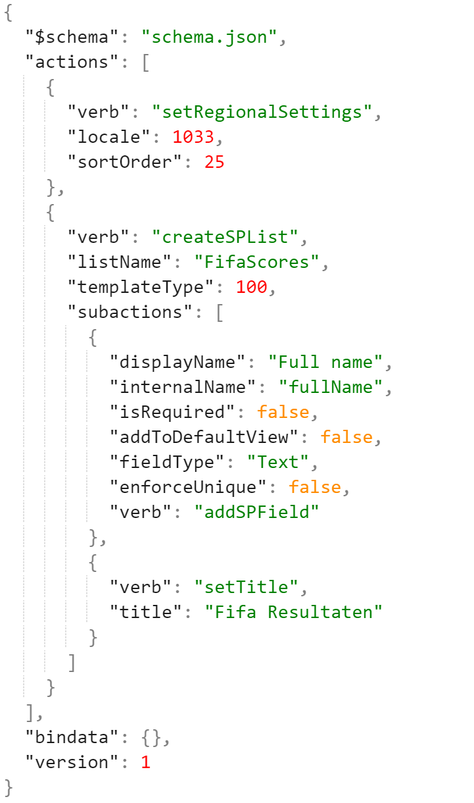
Example of a Site Script
Two actions
setRegionalSettings
createSPList
Subacties
addSPField
Sequential

Slide 14
SP Site Designer Tool
You don’t need to type or memorize the JSON.
There are wonderful tools available!
SharePoint Site Designer Beta
Mikko Punamäki – sitedesigner.io

Slide 15

Demo Creating a Site Script

Slide 16
What is a Site Design?
A collection of site scripts
Makes our site scripts useable wrapped in a site design
Modern way of provisioning templates
Supported on SPO for Communication & Team sites
Possibility to set a custom site design as default
User interface available
Permissions

Slide 17
Pros, Cons & Considerations
Pros
Out of the box (supported) Apply a Site Design from the UI Use REST API to apply a Site Design Set permissions Regular updates from Microsoft Export lists and sites (soon)

Slide 18
Pros, Cons & Considerations
Pros | Cons & Coniderations
Out of the box (supported) Apply a Site Design from the UI Use REST API to apply a Site Design Set permissions Regular updates from Microsoft Export lists and sites (soon) | No content provisioning (webparts) No built-in UI for management of site scripts/designs (API’s, CLI/CSOM/PnP) Limited functionality compared to PnPCore/CSOM Maturity (~2 years) Updating a site script will not update existing provisioned sites

Slide 19
Site Designs Limits
Tenant
100 site designs
100 site scripts
Normal Site Design | Large Site Design
30 actions 20k characters API Endpoint: ApplySiteDesign (sync) | 300 actions 100k characters API Endpoint: AddSiteDesignTask (async, queued) → also works with smaller site designs

Slide 20
Additional Provisioning Methods
Trigger a flow action from a Site Design to take advantage of the following:
CSOM
REST API (PnPjs)
PnPCore via C# or PowerShell
CLI
SPFx (Feature Framework)
3rd party tools: ShareGate

Slide 21
Handy links
Samples (JSON)
https://github.com/SharePoint/sp-dev-site-scripts
SharePoint Site Designer Tool
https://www.sitedesigner.io
Site Script JSON Schema Reference
https://docs.microsoft.com/en-us/sharepoint/dev/declarative-customization/site-design-json-schema
Calling Microsoft Flow from a site script
https://docs.microsoft.com/en-us/sharepoint/dev/declarative-customization/site-design-trigger-flow-tutorial

Slide 22
Demo Site Designs & PnPjs

Slide 23
Site Designs & PnPjs
Building a provisioning solution

Slide 24
The Solution
Site design to provision the site structure
Contains actions to provision assets
Install a custom “Hello Biwug 2019” SPFx solution
Also contains a Feature Framework asset to provision a custom list
Contains a FlowTrigger action which will run an Azure Function
Azure Function to execute our PnPjs code
Will add our “Hello Biwug 2019” webpart to the homepage
Add some content in our lists
Etc ..

Slide 25
Demo Provisioning Solution

Slide 26
Thank you for listening!
Questions?

